Slide 1
CSS Grid or Flexbox Compare and Combine
Aaron LuBean (alubean@ChurchOfJesusChrist.org)
Mary Ebert (tikvahh@ChurchOfJesusChrist.org)
FamilySearch Web Developers
October 8, 2019
Notes:
Intro to presenters. To get a feel for our audience, please raise your hand if you have a good working knowledge of CSS? How many of you are familiar with CSS Flexbox? How about CSS Grid? Any UX or designers in the house? How many of you have or are actively using CSS Flexbox or Grid in real projects?
For 23 years, since Internet Explorer version 3, CSS has been used to design the layout and look n’ feel of web pages, but making complicated & responsive layouts AND getting them working correctly across different browsers has always been a challenge. We’ve used tables, inline-block, floats, positioning, and several other hacks, but none of these techniques could easily accomplish some very basic layouts, e.g. two-column layouts, vertical centering. Flexbox and Grid were designed from the ground up to do complex & responsive layouts. But, which of these should you use, and can they be used together? That’s what this presentation is about.
FOR UX/DESIGNERS: Ever since the 1940s when the Swiss started using grids as a tool, designers have been using grids to bring order to pages. In the modern web era, several grid design systems have been created, e.g. Twitter Bootstrap, 960, and Material.io’s grid systems, which are based on 12-column layouts. But these systems often use similar hacks. Some frameworks (like Material UI) are using CSS Flexbox, and others are starting to use CSS Grid. But, once you understand Flexbox and Grid, you don’t necessarily need to use libraries and frameworks to do responsive grid layouts. And, you’re not limited to 12 column layouts, nor do you have to do all the math for what exact column width percentages are, etc.

Slide 2
Flexbox or Grid for layout?
Flexbox
one-dimensional, content-first approach
Grid
two-dimensional, layout-first approach
Notes:
Flexbox aims to layout, align and allocate space among items in a container, even when their size is unknown or dynamic, hence the word “flex”. Chris Coyier, from css-tricks.com, said, “The main idea behind the flex layout is to give the container the ability to alter its items’ width/height (and order) to best fill the available space (mostly to accommodate to all kind of display devices and screen sizes).”
Grid aims at a two-dimensional layout of items, so it can manage both columns and rows, like tables. But, several layouts are easier with CSS grid than they were with tables. For example, a grid container’s children can place themselves so they truly overlap and layer, just like CSS positioned elements (we’ll talk about overlapping later).
IF YOU ONLY GET ONE THING OUT OF THIS PRESENTATION TODAY, THIS IS IT: The core difference between Flexbox and Grid is the approach —Flexbox’s approach is content-first, while Grid’s approach is layout-first. Flexbox’s layout is calculated after its content is loaded and Grid’s layout is calculated regardless of the content inside. Because of this, you’ll generally avoid using Flexbox for overall page layout.
SOME OTHER WAYS OF LOOKING AT IT: If you are well aware of your content before making layout, then blindly opt for Flexbox, and if not, opt for Grid. Flexbox is best suited when components of a layout are fundamentally linear, whereas Grid is better suited when the layout isn’t linear. Flexbox is great for small-scale layouts. Grid is better for large-scale layouts, but can also be used well for small-scale web components. If you only need to define a layout as a row OR as a column, then choose Flexbox. If you want to define a grid and fit content into two dimensions, then choose Grid.

Slide 3
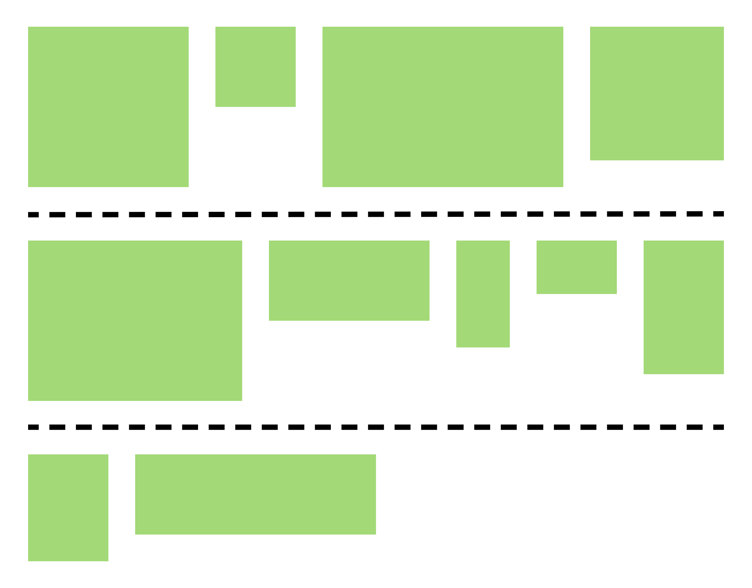
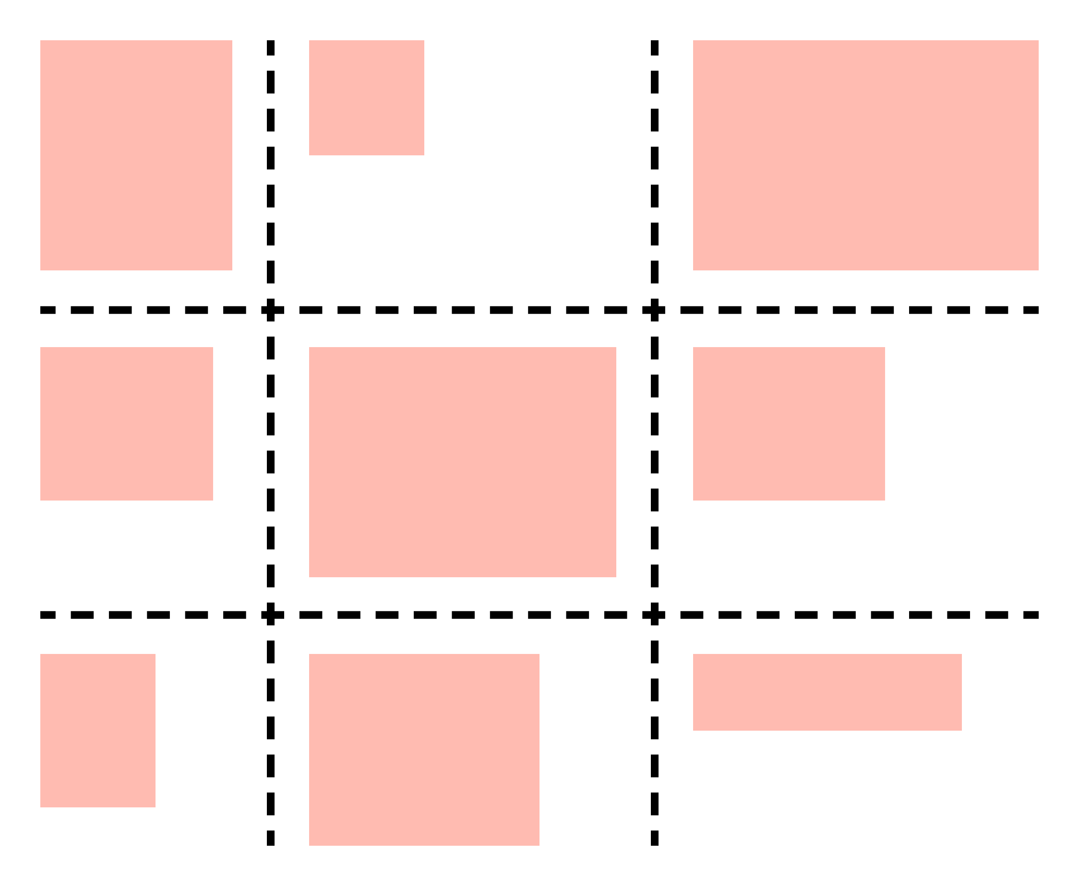
Flexbox vs. Grid
Flexbox lines ‘em up in one direction
Grid lines ‘em up in two directions
Notes:
Flexbox lines things up in one direction, so if you are wrapping items, you can get this kind of staggered look (see image). Items are lined up per row, with no regard to how they are lined up on other rows. You can see that things are not lined up in columns.
Grid lines things up in two directions (see image).
EXAMPLE
Wrapping in Flexbox vs. Grid: https://codepen.io/aaronlubean/pen/WNeWXrr

Slide 4
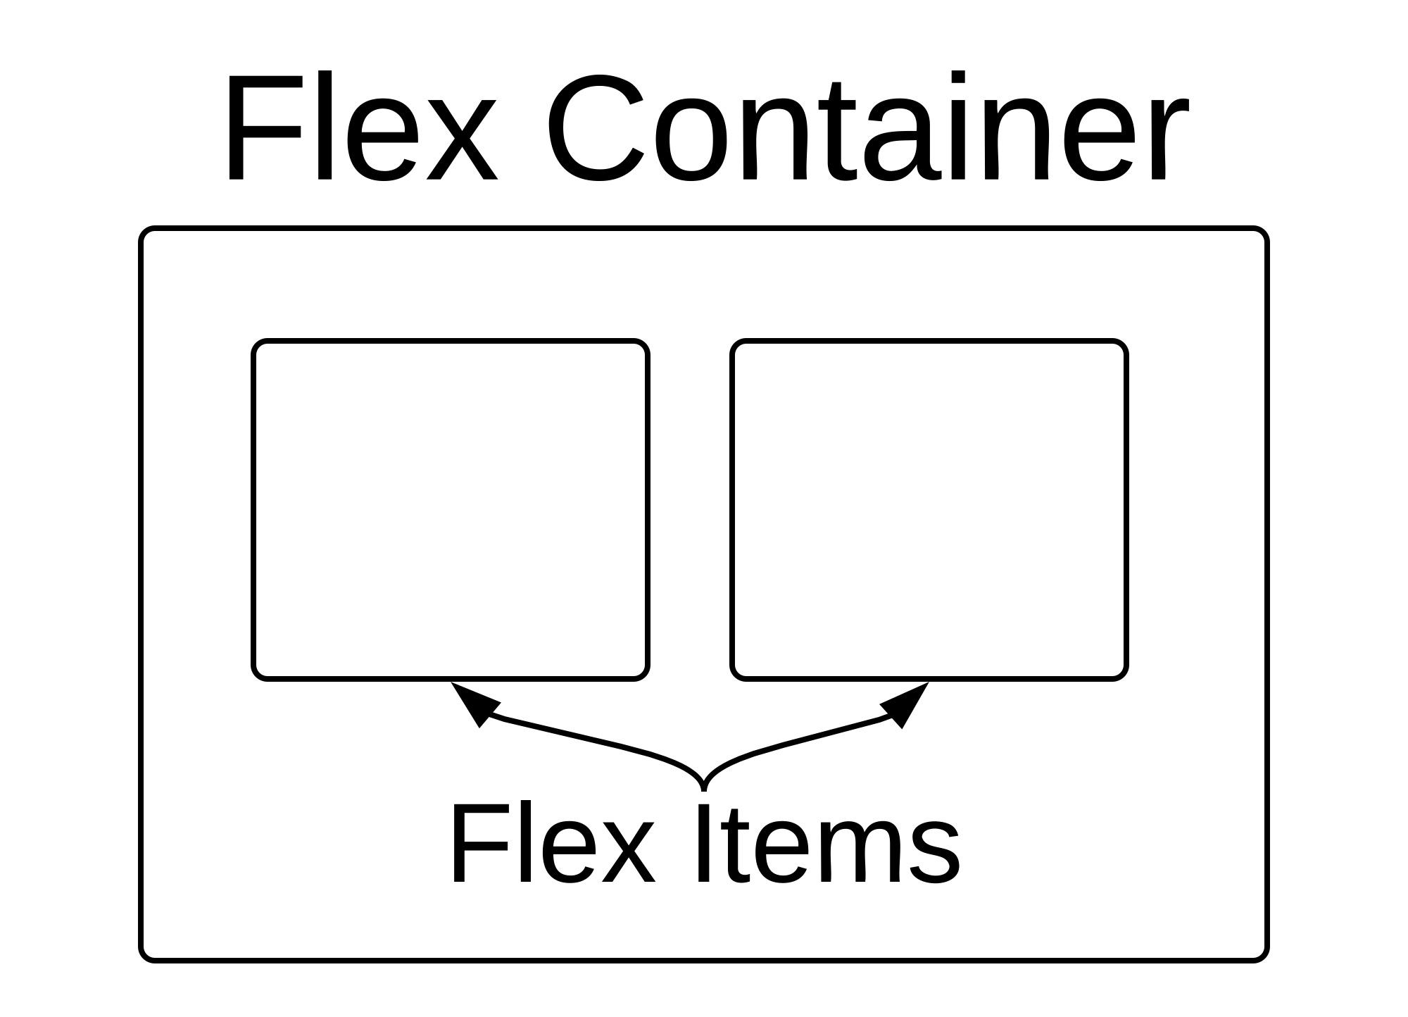
Flexbox Anatomy & Terminology
Container – display: flex;
flex-direction: row | row-reverse | column | column-reverse
flex-wrap: nowrap | wrap | wrap-reverse
justify-content: flex-start | flex-end | center | space-between | space-around | space-evenly
align-items: stretch | flex-start | flex-end | center | baseline
align-content: stretch | flex-start | flex-end | center | space-between | space-around
Flex Item – direct child of container
order: 0 | <integer>
flex: 0 1 auto | <grow> <shrink> <basis> | none
align-self: auto | flex-start | flex-end | center | baseline | stretch
Notes:
FLEX CONTAINER defined by display: flex
flex-direction - This establishes the main-axis, thus defining the direction flex items are placed in the flex container. Flexbox is (aside from optional wrapping) a single-direction layout concept. Think of flex items as primarily laying out either in horizontal rows OR vertical columns.
flex-wrap - By default, flex items will all try to fit onto one line. You can change that and allow the items to wrap as needed with this property.
justify-content - This defines the alignment along the main axis. It helps distribute extra free space left over when either all the flex items on a line are inflexible, or are flexible but have reached their maximum size. It also exerts some control over the alignment of items when they overflow the line.
align-items - This defines the default behavior for how flex items are laid out along the cross axis on the current line. Think of it as the justify-content version for the cross-axis (perpendicular to the main-axis).
align-content - This aligns a flex container's lines within when there is extra space in the cross-axis, similar to how justify-content aligns individual items within the main-axis.
FLEX ITEM
order - By default, flex items are laid out in the source order. However, the order property controls the order in which they appear in the flex container.
flex shorthand – flex-grow - This defines the ability for a flex item to grow if necessary. It accepts a unitless value that serves as a proportion. It dictates what amount of the available space inside the flex container the item should take up. If all items have flex-grow set to 1, the remaining space in the container will be distributed equally to all children. If one of the children has a value of 2, the remaining space would take up twice as much space as the others (or it will try to, at least). flex-shrink - This defines the ability for a flex item to shrink if necessary. flex-basis - This defines the default size of an element before the remaining space is distributed. Think of as a fancy version of width (if the container’s flex-direction is set to row or row-reverse) or height (if the container’s flex-direction is set to column or column-reverse). An item’s flex-basis as the ideal amount of space an item will take up before it is forced to grow or shrink. It can be a length (e.g. 20%, 5rem, etc.) or a keyword. The “auto” keyword means "look at my width or height property”. The “content” keyword means "size it based on the item's content" - this keyword isn't well supported yet, so it's hard to test and harder to know what its brethren “max-content”, “min-content”, and “fit-content” do. If set to 0, the extra space around content isn't factored in. If set to auto, the extra space is distributed based on its flex-grow value. Flex-basis can be constrained by min-width, max-width, min-height, and max-height of the flex item.
align-self - This allows the default alignment (or the one specified by align-items) to be overridden for individual flex items.
EXAMPLES
Flexbox Playground: http://the-echoplex.net/flexyboxes
Holy Grail – Flexbox: https://codepen.io/aaronlubean/pen/LYPvWWV

Slide 5
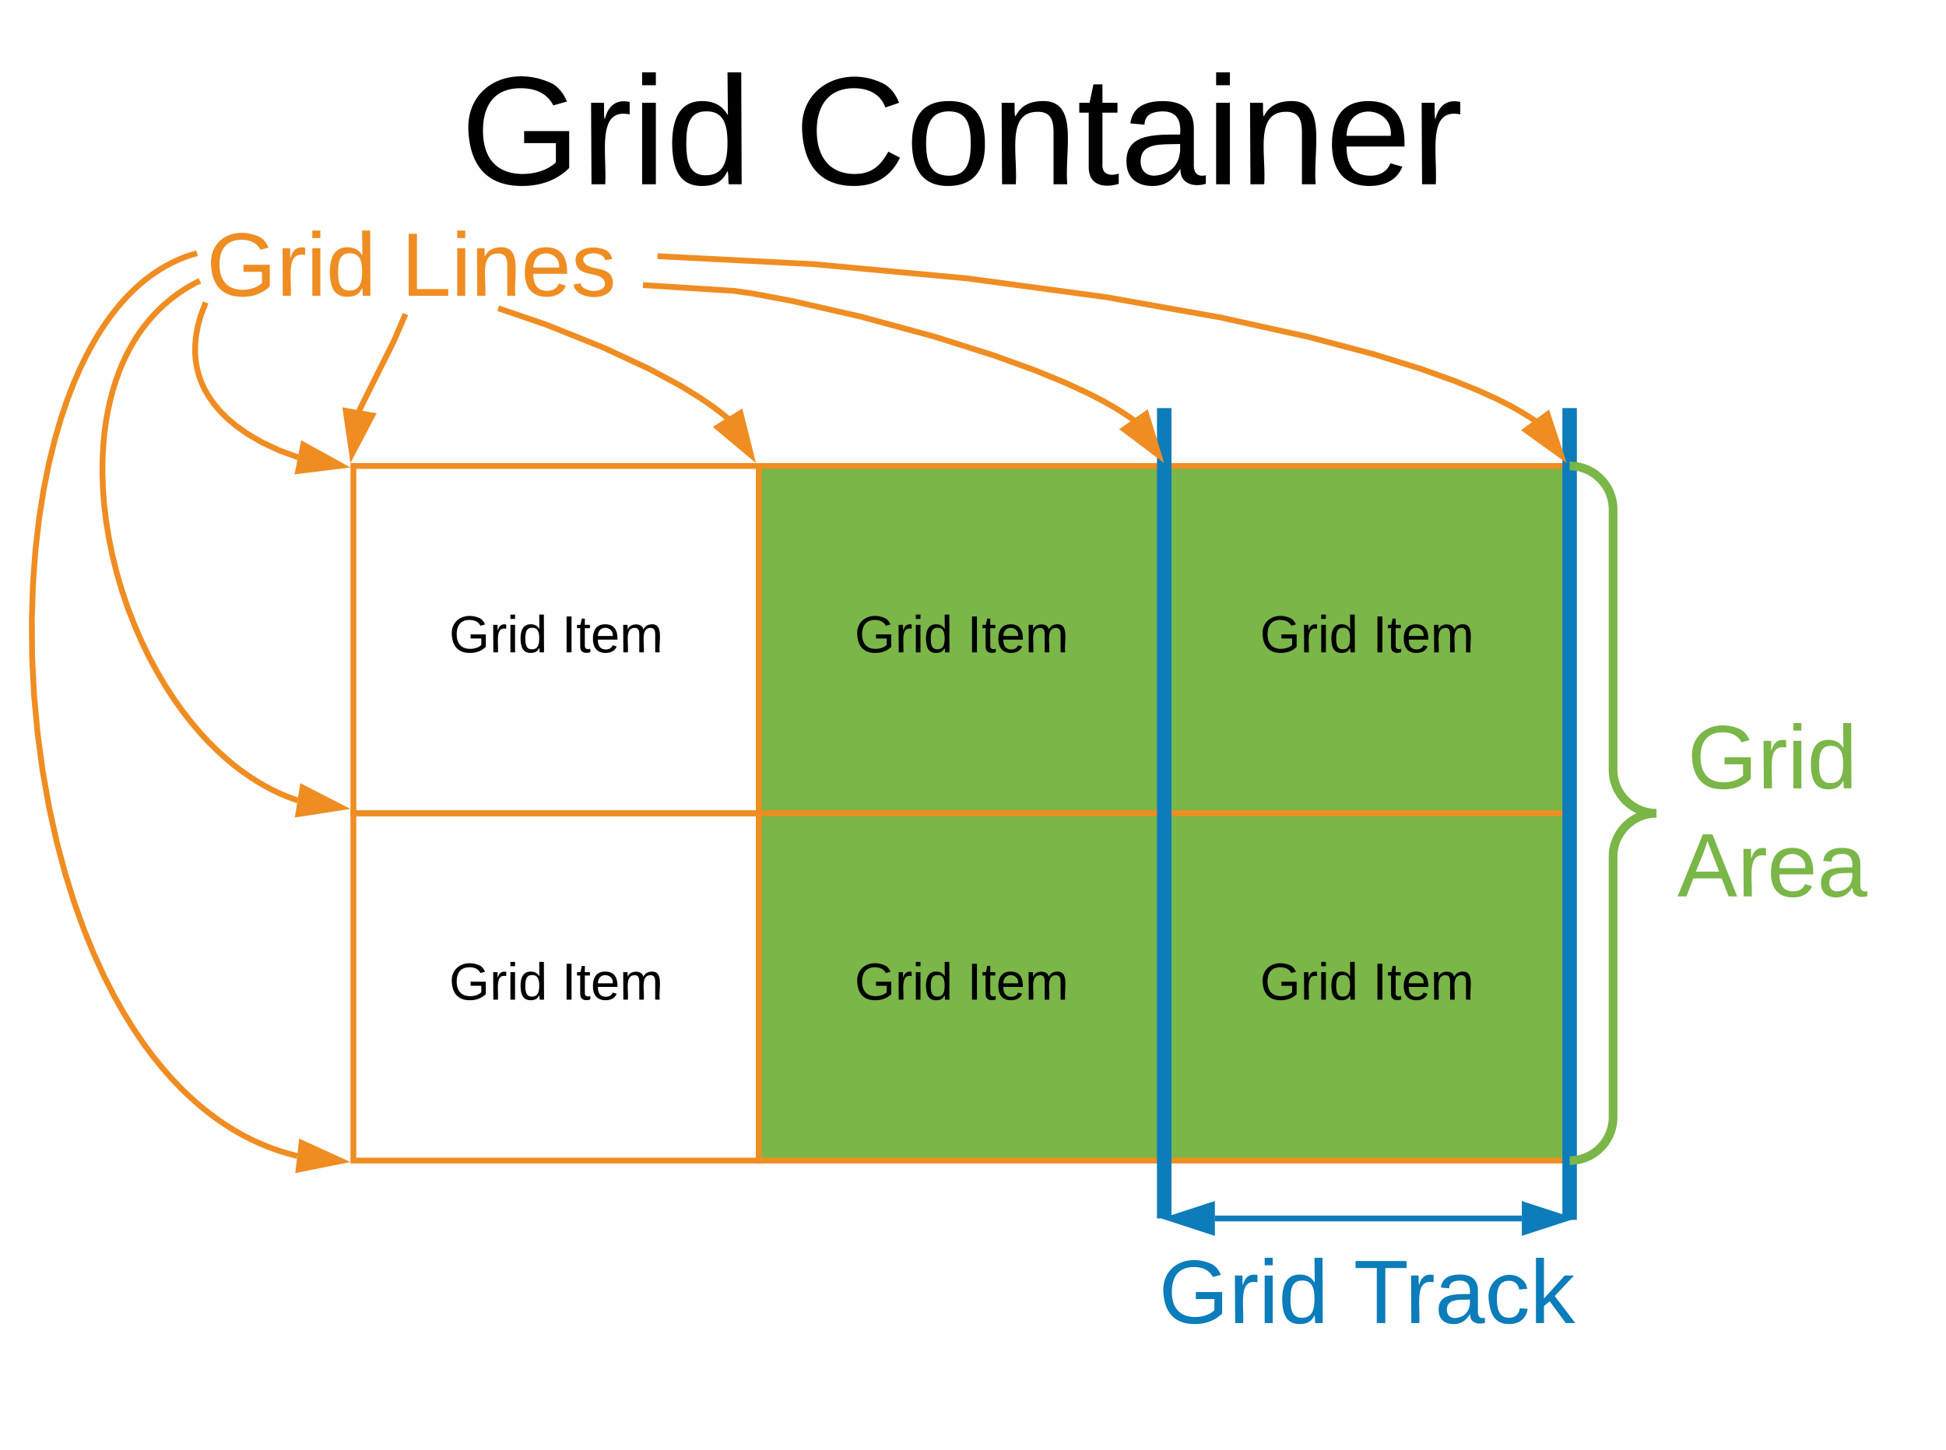
Grid Anatomy & Terminology
Container – display: grid;
grid-template-columns: <track-size> … | [line-name] <track-size> …
grid-template-rows: <track-size> … | [line-name] <track-size> …
grid-template-areas: "<grid-area-name> | . | none | …" ...
grid-auto-columns: <track-size> …
grid-auto-rows: <track-size> …
grid-auto-flow: row | column | row dense | column dense
grid-gap: <grid-column-gap> <grid-row-gap>
justify-items: start | end | center | stretch
align-items: start | end | center | stretch
justify-content: start | end | center | stretch | space-around | space-between | space-evenly
align-content: start | end | center | stretch | space-around | space-between | space-evenly
Grid Item – direct child of container
grid-column: <start-line> / <end-line> | <start-line> / span <value>
grid-row: <start-line> / <end-line> | <start-line> / span <value>
grid-area: <grid-area-name> | <row-start>/<column-start>/<row-end>/<column-end>
justify-self: start | end | center | stretch
align-self: start | end | center | stretch
Notes:
Let's talk a little about Grid anatomy and terminology​
​
A grid is made up by of a GRID CONTAINER with COLUMNS and ROWS which are also called TRACKS. It is defined by display: grid, which has an auto behavior that can be changed with the following options: ​
​
grid-template-columns and grid-template-rows – Which define the columns and rows (aka a space-separated list of values). The values represent the track size, and the space between them represent the grid line.
​
grid-template-areas - Defines a grid template by referencing the names of the grid areas which are defined on a grid item. Repeating the name of a grid area causes the content to span those cells. A period signifies an empty cell. The syntax itself provides a visualization of the structure of the grid.​
​
grid-auto-columns, and grid-auto-rows, specify the size of any auto-generated grid tracks (aka implicit grid tracks). Implicit tracks get created when there are more grid items than cells in the grid or when a grid item is placed outside of the explicit grid. If you have grid items that you don't explicitly place on the grid, the auto-placement algorithm kicks in to automatically place the items. grid-auto-flow This property controls how the auto-placement algorithm works. Using the dense option will place items outside of document order. NOTE: this works with both the template-areas, and template-columns and rows.​
​
grid-gap - Specifies the size of the grid lines. You can think of it like setting the width of the gutters between the columns/rows.​
​
justify-items Aligns grid items along the inline (row) axis (as opposed to align-items which aligns along the block (column) axis). This value applies to all grid items inside the container.​
​
The total size of your grid might be less than the size of its grid container. This could happen if all of your grid items are sized with non-flexible units like px. In this case you can set the alignment of the grid within the grid container using justify-content. This property aligns the grid along the inline (row) axis (as opposed to align-content which aligns the grid along the block (column) axis).​
​
Once you've defined the grid container, you can define some additional properties on the grid item, which override the containers configuration, such as:​
​
grid-column and grid-row are used to determines a grid item's location within the grid by referring to specific grid lines. start-line is the line where the item begins, and end-line is the line where the item ends.​
grid-area - gives an item a name so that it can be used with the grid-template-areas property. ​
justify-self - Aligns a grid item inside a cell along the inline (row) axis (as opposed to align-self which aligns along the block (column) axis).​
​
EXAMPLES:​
https://gridbyexample.com​
​
Holy Grail – Grid: https://codepen.io/aaronlubean/pen/ZEzwwEW​ - Note that while we are using CSS media queries here and explicit track placement, there is no need for that when doing implicit track placement (we’ll come back to that).

Slide 6
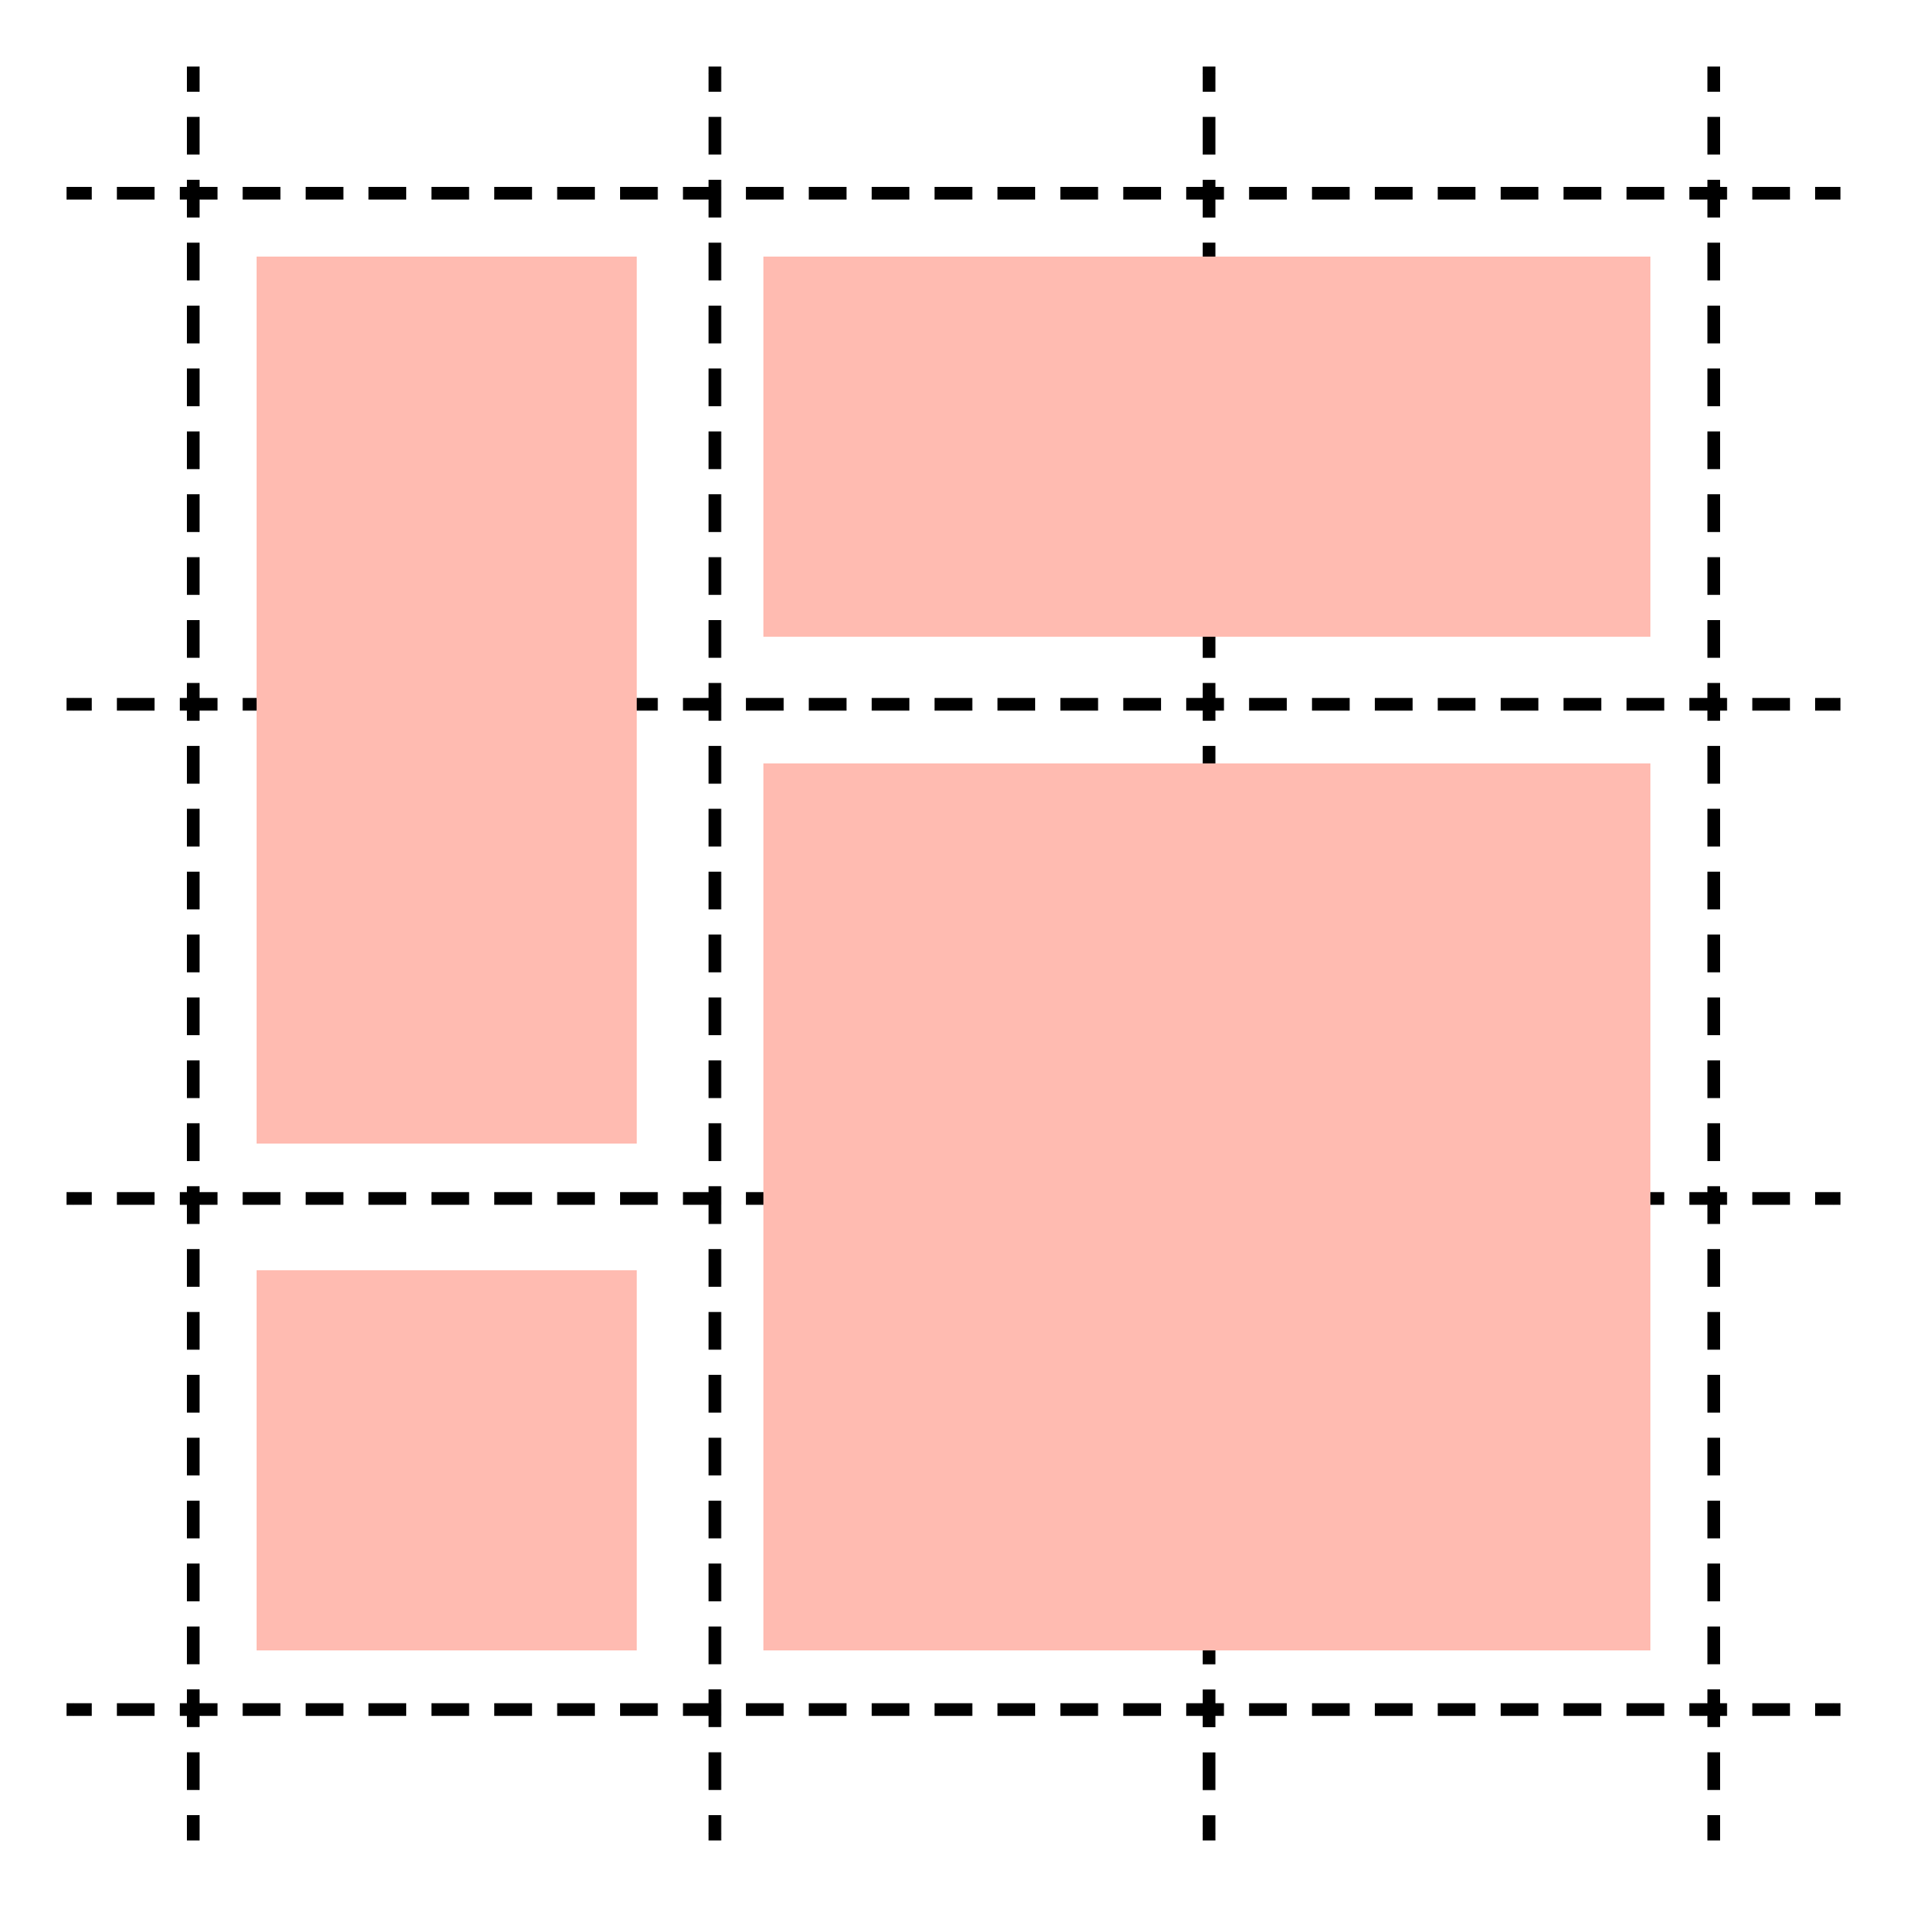

Column/row span & layering in Grid
Notes:
You can explicitly specify how rows and columns in your grid are spanned. You can also use z-index to specify how layering or overlapping works.
You cannot do row spans or layering in Flexbox.
EXAMPLES
Track Spanning in Grid: https://codepen.io/rachelandrew/pen/oXKgwa
Layering in Grid: https://codepen.io/rachelandrew/pen/KpOwQW

Slide 7
Grid Special Functions and Keywords
fr length unit
min-content, max-content, auto
minmax()
repeat() function w/ auto-fill & auto-fit
Notes:
CSS Grid Layout introduces a new unit of length called “fr”, which is short for “fraction”, and it represents a fraction of the available space in the grid container. You can mix fixed and relative length units (px, em, rem) with flexible length units (%, fr).
min-content - The smallest size a grid item could take that doesn’t lead to overflow that could be avoided by choosing a larger size.
max-content - A grid item's “ideal” size in a given axis when given infinite available space. Usually this is the smallest size the box could take in that axis while still fitting around its contents, i.e. minimizing unfilled space while avoiding overflow.
minmax function makes it easy to create grid tracks that have a size value between a certain range.
If you find yourself repeating length units, use the CSS repeat() function. Auto-fill and auto- fit fill the row with as many columns as it can fit
EXAMPLE
Responsive Gallery w/o media queries - Grid: https://codepen.io/aaronlubean/pen/vYBqMaE - While showing this example explain that there are no media queries as we are using implicit track placement.

Slide 8
Key Differences
Approach
Flexbox: one-dimensional, content-first approach
Grid: two-dimensional, layout-first approach
Explicit Layouts Easier
More Concise Media Queries
Layering & Spanning
works in Grid, hacked in Flexbox
Grid Has Gap
CSS Animations – better support in Flexbox
Notes:
PLEASE NOTE - Fundamentally, you can do just about everything in Flexbox as you can do in Grid and vice versa.
Approach - Flexbox: one-dimensional, content-first approach - Grid: two-dimensional, layout-first approach.
Explicit Layouts Easier in Grid - If your page, app, or component needs to conform to a certain layout, like the holy grail layout, it is easier to be explicit using Grid. Use grid-template-areas instead of grid lines to make it easier.
More Concise Media Queries in Grid – Using grid-template-areas makes it easier to declare the changes in layout at different breakpoints. If you are using implicit track placement, there is less need to even have CSS media query breakpoints.
Layering & Spanning - We mentioned earlier that you can’t do layering in Flexbox, but you actually can - it requires some hacks using traditional stuff, like negative margins, transforms, or absolute positioning in order to break out of the flex behavior. So, it’s probably best to stick with Grid when wanting to do overlapping.
Grid has gap, Flexbox doesn’t (at least not yet), so for now you have to fiddle with outside or inside padding/margins. Firefox has added gap to Flexbox, but no other browsers support it. It may be coming in the future.
CSS Animations - One advantage of Flexbox over Grid is more support of CSS transitions or animations, e.g. Flexbox flex-grow values can be transitioned, but for Grid the only well-supported transition property is grid-gap (Firefox also supports the animation of grid-template-rows/columns, and Chrome is starting to catch up).
EXAMPLES
Animating grid-gap: https://codepen.io/matuzo/pen/rmQvMG
Animating grid-template-rows/columns: https://codepen.io/michellebarker/pen/oJmZKK !!! Use Firefox!!!

Slide 9
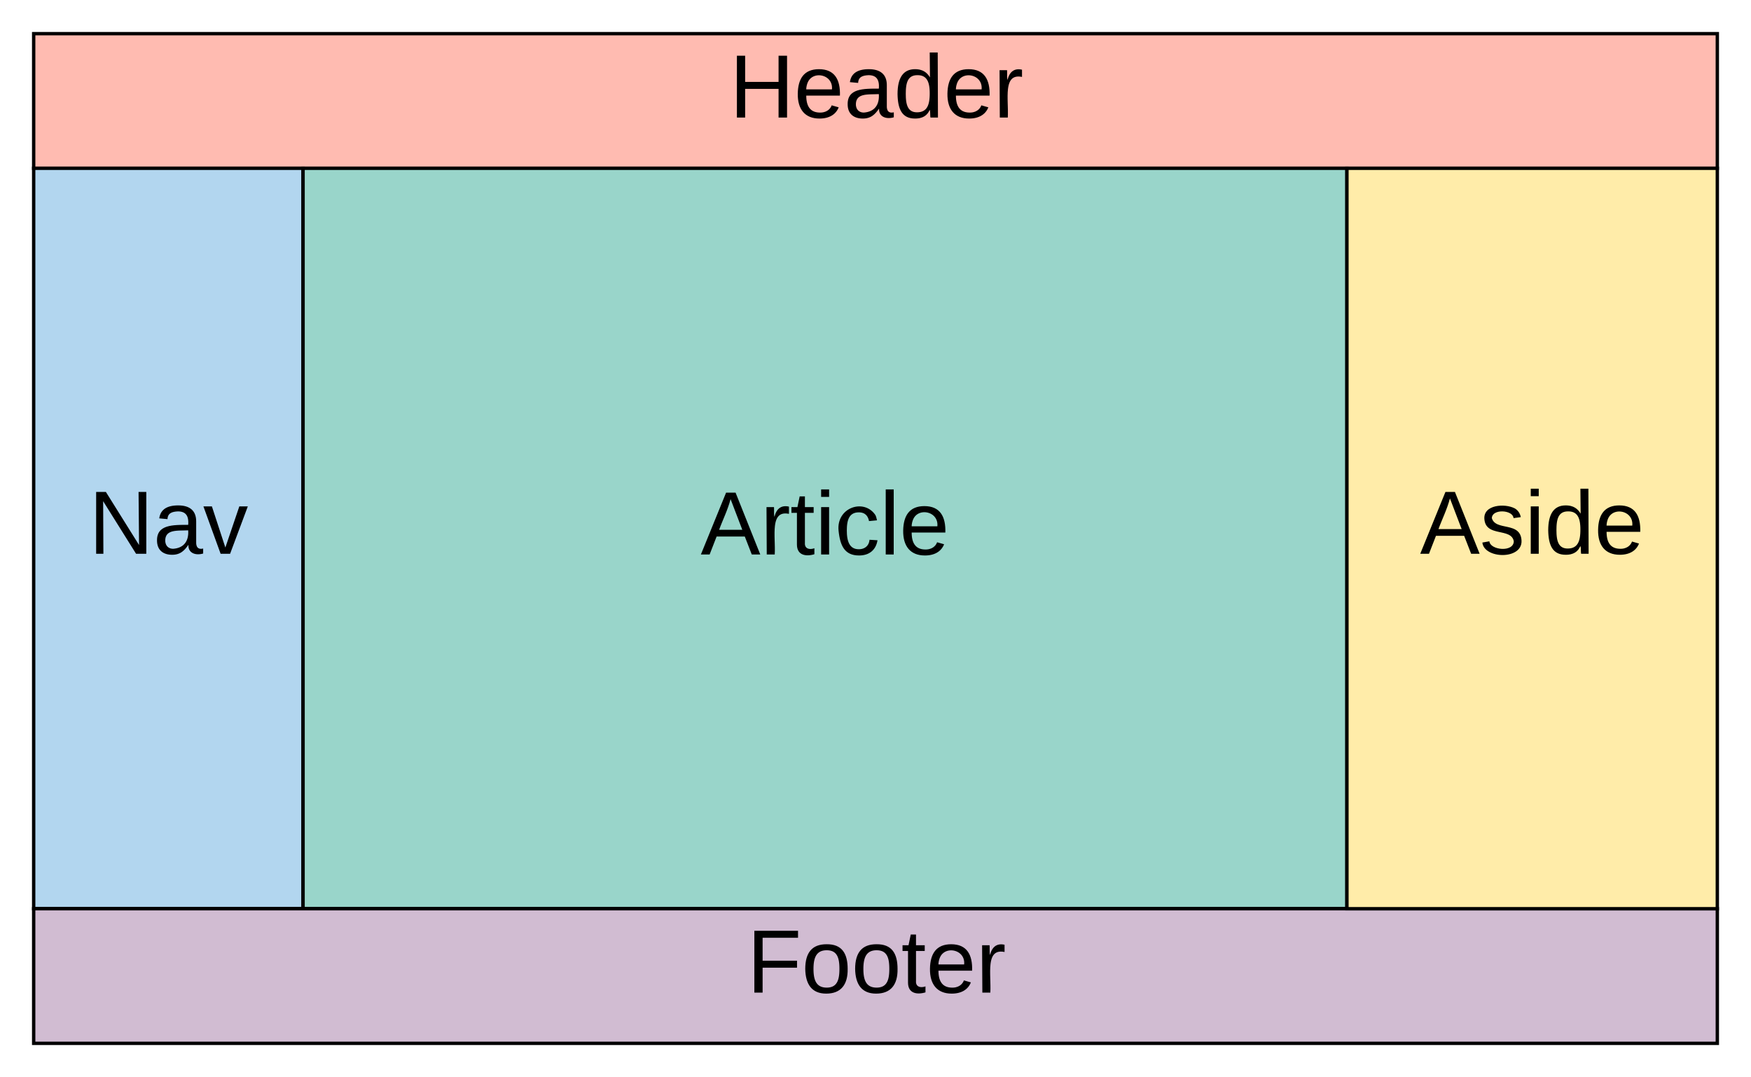
Combining Grid and Flexbox
Can Grid and Flexbox be used together?
Let’s do a combined Holy Grail layout
Notes:
Absolutely, CSS Grid and Flexbox can be used together.
EXAMPLE:
Holy Grail - Grid & Flexbox: https://codepen.io/aaronlubean/pen/MWgLxbQ

Slide 10
Code & References
Slides and examples: https://github.com/aaronlubean/grid-v-flexbox
Wrapping in Flexbox vs. Grid: https://codepen.io/aaronlubean/pen/WNeWXrr
Flexbox Playground: http://the-echoplex.net/flexyboxes
Holy Grail – Flexbox: https://codepen.io/aaronlubean/pen/LYPvWWV
Grid Playground: https://gridbyexample.com
Holy Grail – Grid: https://codepen.io/aaronlubean/pen/ZEzwwEW
Track Spanning in Grid: https://codepen.io/rachelandrew/pen/oXKgwa
Layering in Grid: https://codepen.io/rachelandrew/pen/KpOwQW
Responsive Gallery w/o media queries - Grid: https://codepen.io/aaronlubean/pen/vYBqMaE
Animating grid-gap: https://codepen.io/matuzo/pen/rmQvMG
Animating grid-template-rows/columns (Firefox Only): https://codepen.io/michellebarker/pen/oJmZKK
Holy Grail – Grid & Flexbox: https://codepen.io/aaronlubean/pen/MWgLxbQ
https://css-tricks.com/snippets/css/a-guide-to-flexbox
https://css-tricks.com/snippets/css/complete-guide-grid
https://cssgrid.io

Slide 11


Thanks & Questions
SORT
Chris Wills, © 2012 by Intellectual Reserve, Inc. All rights reserved.

